Slide 1

BLOCKBUSTERS STEALTH LLC
Business Analysis Presentation
By Maria Aisling Tortosa

Slide 2

Project Situation and Objectives
As a movie rental Rockbusters Stealth LLC is planning to use existing movie licenses to launch an online video rental service in order to stay competitive in the growing online streaming services market
The purpose of this presentation is to help Rockbusters Stealth’s management team to develop a business strategy for their new online service.

Slide 3

Key Business Questions
Which movies contributed the most and least to revenue gain?
What was the average rental duration for all videos?
Which countries are Rockbusters’ customers based in?
Where are customers with a high lifetime value based?
Do sales figures vary between geographic regions?

Slide 4

Data Summary
Rockbusters General Rental Information Film Ratings & Numbers
Number of Movies | 1000
Number of Genres | 17
Languages | English
Rating | Numbers
NC-17 | 210
R | 195
PG-13 | 223
PG | 194
G | 176
 | Rental Duration | Rental Rate | Movie Length
Minimum | 3 | 0.99 | 46
Maximum | 7 | 4.99 | 185
Average | 5 | 2.98 | 115

Slide 5
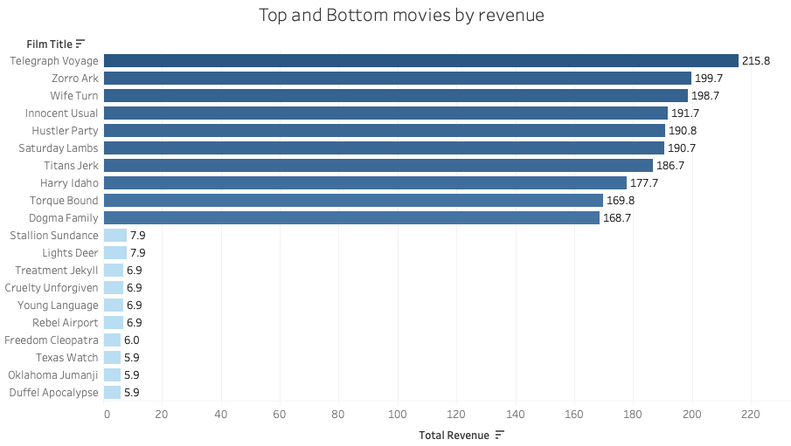

1. a. Movies that generated the most & least revenue.
The following visualizations highlights the top 10 and bottom 10 movies by revenue generated.
By comparing numbers to the total revenue, we can say the the top 10 movies account for 3.1% of all revenue while the bottom 10 only account for 0.1%.

Slide 6

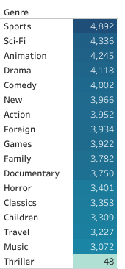
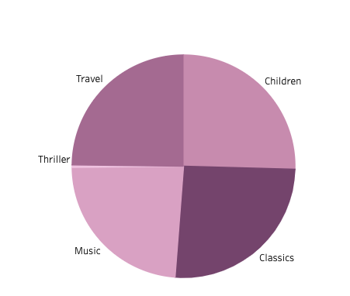
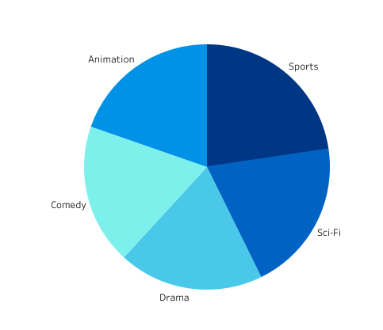

1.b Genres ranked by revenue
Top 5 genres by revenue
Bottom 5 genres by revenue
The Sports genre generated the most revenue accounting for 8% of sales.
The Thriller genre generated the least revenue accounting for only 0.1% of sales.

Slide 7

2. Average rental duration for all movies
The average rental duration is 5 days at an average rental rate of $2.98 and an average replacement cost of $19.98.
 | Rental Duration | Rental Rate | Movie Length
Average | 5 days | $ 2.98 | 115 mn

Slide 8

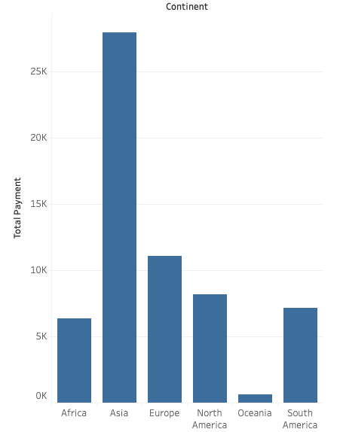
3. Global Audience Geographical distribution
The continent with the most customers is Asia followed by Europe.
The top 10 countries with most customers are :
India, China, United States, Japan, Mexico, Brazil, Russian Federation, Philippines, Turquey and Indonesia.
Whilst these 10 countries only represent 10.9% of the 109 where we have a footprint in terms of revenue, they represent an astonishing 51.9% of sales.

Slide 9
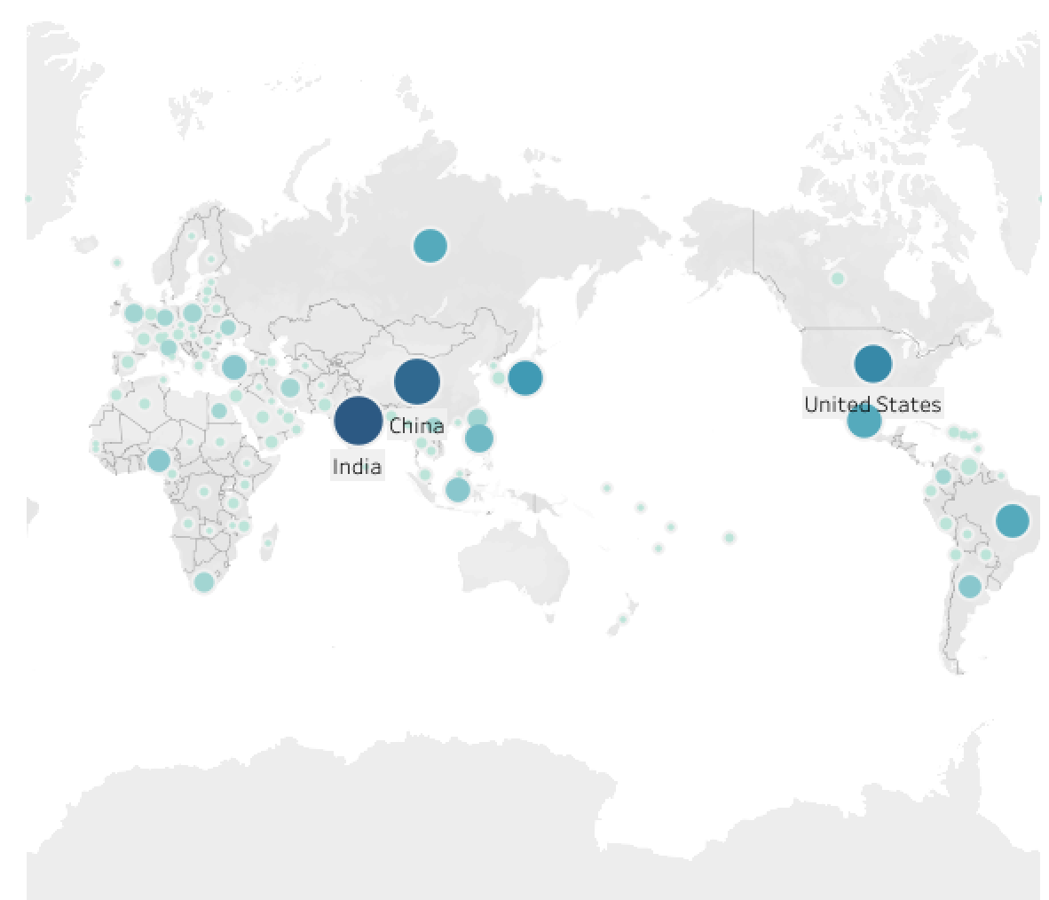

Visual customer distribution per country

Slide 10
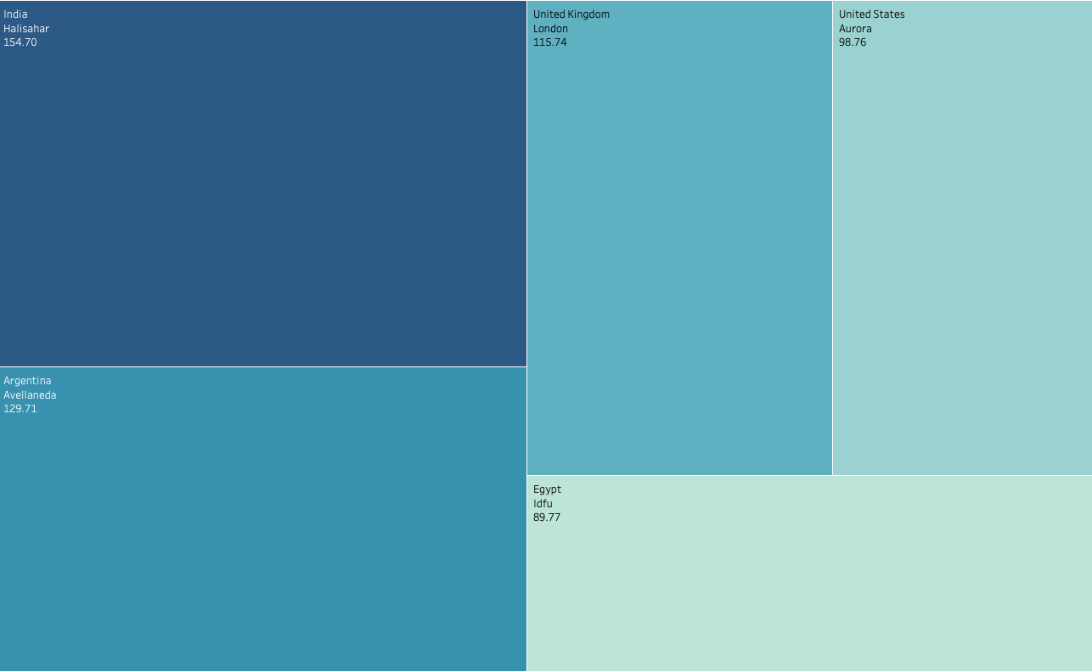


4. Where are customers with a high lifetime value based
At this point we can conclude that whilst customers with the highest lifetime value are spread across many cities and countries the leading continent remains Asia with India at the top of the list.

Slide 11
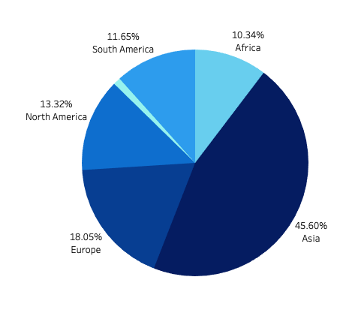

5. Do sales figures vary between geographical regions?
Based on all the previous information we have been reviewing and this last chart it is clear, that sales figures vary depending on city, country and continent. It is important to highlight how Asia alone holds almost 50% of the sales figures.

Slide 12

5. Actions and Recommendations
Given the high percentage of revenue received from Asia we should look at creating a reward program for our most loyal customers.
Launch the product initially in those regions with higher number of customers such as Asia, Europe and North America.
A further study into the top genres by revenue , by most popular movies and by geo location would be recommended in order to ensure we supply movies according to customer preference across the globe.
I would highly recommend assessing lower revenue areas in order to determine is there a pattern and is there a market worth investing in.

Slide 13
Thank you
Have you got any questions?
aisling.mynes@gmail.com

